Slide 1

Conflict Management
Resources and support systems at ISTA
9 September 2026

Slide 2
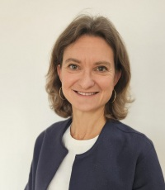


Sophie Menapace Verena Seiboth
Conflict Advisor
Ombudsperson
Interpersonal issues at the work place
Responsible Conduct of Research

Slide 3
Today‘s Topics
Conflicts
Academic misconduct
Duties & responsibilities
Help & support
When to contact Conflict Advisor (CA) & Ombudsperson
Open discussion

Slide 4
Workplace conflicts
Definition of workplace conflicts
Disagreement or clash between people or groups that arises from differences in opinions, priorities, communication styles, responsibilities or interests.
A conflict is neither good nor bad, it is what you make out of it that counts.
Role of the Conflict Advisor
Providing a safe space where people can discuss interpersonal challenges and explore options in a confidential and impartial setting.

Slide 5
Common causes of conflicts
Personality/cultural/generational issues
Pressure / self-imposed pressure
Excessive/mismatched expectations
Misconception regarding or unknown obligations, rules, code of conduct
Unclear roles, tasks
(Perceived) hierarchy as barrier to address issues
Feeling of lack of appreciation
Most important:
Miscommunication
Apprehension to address issues (before they become pressing)

Slide 6
What can you do to prevent conflicts
Communicate Respectfully – Listen, ask questions, avoid assumptions.
Address Issues Early – Speak directly to those involved.​
Show Respect – Be courteous and professional.
Manage Emotions – Stay calm and respond thoughtfully. ​
Focus on Solutions – Resolve problems, not blame people.
Be Open to Feedback – Treat feedback as an opportunity to grow.
Avoid Gossip – Share concerns directly, not through rumors.
Collaborate – Support colleagues and team goals. ​
Seek Support When Needed – Ask for help if issues cannot be resolved informally. ​​

Slide 7
Scientific misconduct
Examples:
Authorship conflicts
Issues with the progress of publications
Intellectual ownership of projects and data (publications, grant applications)
Concerns about the reproducibility of data
Research misconduct:
Falsification of data
Fabrication of data
Plagiarism
& any other intentional or grossly negligent violations of the standards of Good Scientific Practice

Slide 8

What can you do in case of academic misconduct/ questionable research practices
Authorship
Address the topic of authorship early on in a collaboration and try to revisit in regular intervals this topic as you move forward with your research
Communication is key:
  Supervisors need to discuss/explain decisions
  Involved researchers (postdocs, PhD students, interns, etc.) need to communicate their expectations
Be aware of potential field-specific differences and expectations
Reporting and reproducibility of results
Ask clarification questions (also in writing -> email)
Make suggestions for alternative options or solutions
If something feels ‘wrong‘ because it clearly goes against your values as a scientist, DON‘T DO IT!
  Reach out to us if you are not sure what to do and need clarification.

Slide 9
Duties of all ISTA employees
Commitment to the highest professional standards,
as outlined in the ISTA Code of Conduct and other ISTA documents.
Researchers must follow the Austrian Agency for Research Integrity's Guidelines for Good Scientific Practice and avoid scientific misconduct.
Creating a safe workplace is a shared responsibility:
The employer provides the environment, employees help keep it safe.

Slide 10
Support options at ISTA
Mental health topics → Occupational psychologists, Employee Assistance Program (EAP)
bound to confidentiality
Harassment, bullying, discrimination issues → EDI office, HR
confidential treatment of issues but possibly limited if duty of care requires action to
protect affected employees
Postdoc relevant issues → Postdoc Office
+ Conflict advisor & Ombudspersons

Slide 11
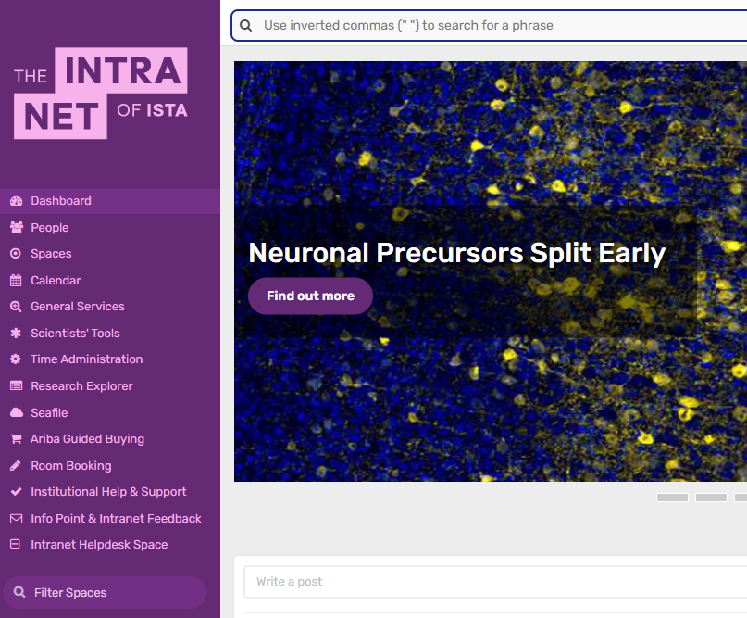

Information on Help & Support on the Intranet
https://helpandsupport.pages.ist.ac.at/

Slide 12
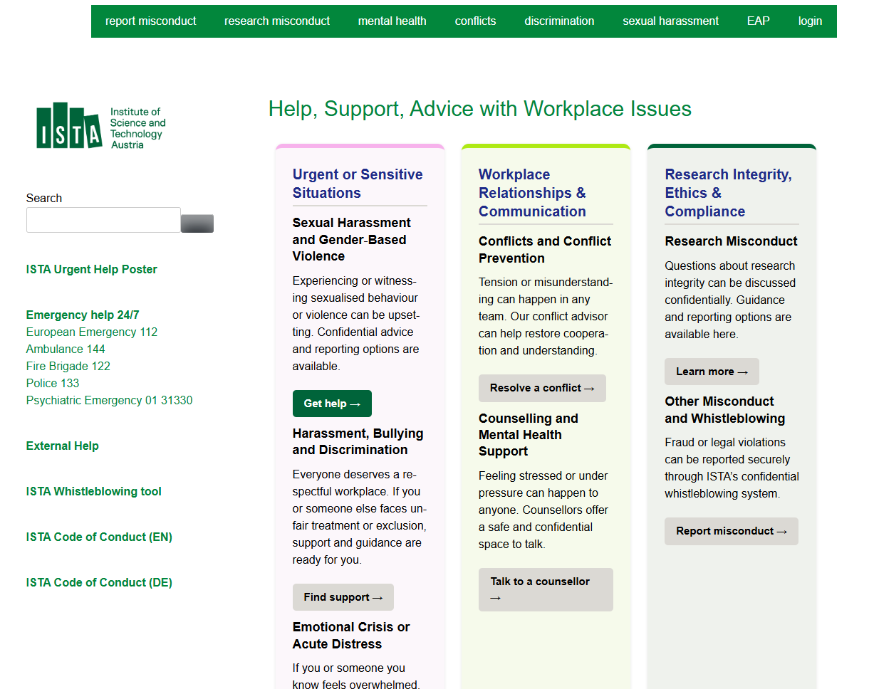
Information on Help & Support on the Intranet (2)
https://helpandsupport.pages.ist.ac.at/

Slide 13
Formal complaints
If the issue cannot be resolved by the individuals involved, a request for a formal investigation can be submitted
Formal complaint in accordance
with the conflict management guideline
Whistleblowing tool
(anonymous) reporting channel regarding legal breach of specific offences such as fraud, misuse of funds or conflict of interest violations etc.
Obligation under EU law
First evaluation by compliance officer and internal audit
Link on the ISTA website in the footer
To request a formal investigation of an issue
First evaluation by HR
Formal investigation through a panel
Submission of request at formal.complaints@ista.ac.at
Further information on the intranet or contact conflict advisor.
Currently under review.
Note: Formal complaints should be considered a last resort. ISTA encourages employees to seek collaborative and constructive solutions whenever possible.
Please reach out to us if you need support in navigating this process.

Slide 14
Research Misconduct Investigation
Reporting of allegation to Ombudsperson.
2nd Ombudsperson is informed. Preliminary investigation will be carried out by the Ombudspersons.
  In the course of the preliminary investigation, the concerned scientists are to be informed of the accusation and be given an opportunity to respond. Maintenance of confidentiality of everyone involved as much as possible, and in particular whistleblower protection, are important aspects of this process.
If a preliminary investigation substantiates the suspicion of research misconduct, the President of ISTA and the member of the Board of Trustees responsible for Research Integrity will decide on the formal investigation:
  Either the investigation is carried out internally by an internal Investigation Committee (pre-determined rules for composition), or the case is forwarded to the Austrian Agency for Research Integrity (OeAWI, https://oeawi.at), with the request to initiate an external, formal investigation.

Slide 15
When to contact the Conflict Advisor
In case of any interpersonal issues at the workplace,
the CA can offer the following support:
Coaching & Guidance – Support in assessing options and planning next steps.
Mediation – Facilitated discussions for teams or groups.
Difficult Conversations – Help preparing for challenging discussions.
Conflict Management Information – Advice on prevention and resolution.
Anonymous Inquiries – Information on policies, rules or employment matters.
Confidential Contact Point – A place to turn when unsure whom to contact.

Slide 16
When to contact an Ombudsperson
For any matters connected to research integrity and ethics
Advice and support:
  Impartial and confidential point of contact for our research community, offering support and guidance on matters addressing ethical dilemmas, scientific misconduct and resolving conflicts that may arise in the course of their research.
Reporting of allegations of research misconduct

Slide 17

Conflict Advisor
Sophie Menapace
Interpersonal issues at the work place
Voestalpine Building, ground floor
Sophie.Menapace@ista.ac.at
Ombudspersons
Verena Seiboth & Beatriz Vicoso
Responsible Conduct of Research
Verena.Seiboth@ista.ac.at (Admin Bldg, 2nd floor)
Beatriz.Vicoso@ista.ac.at (Central Bldg, 1st floor)
Feel free to reach out to us at any time.

